Slide 1
Musical Cubes
“The Three Sided Die”
Eli Doggart, Owen Krause, Matthew Sweeney

Slide 2

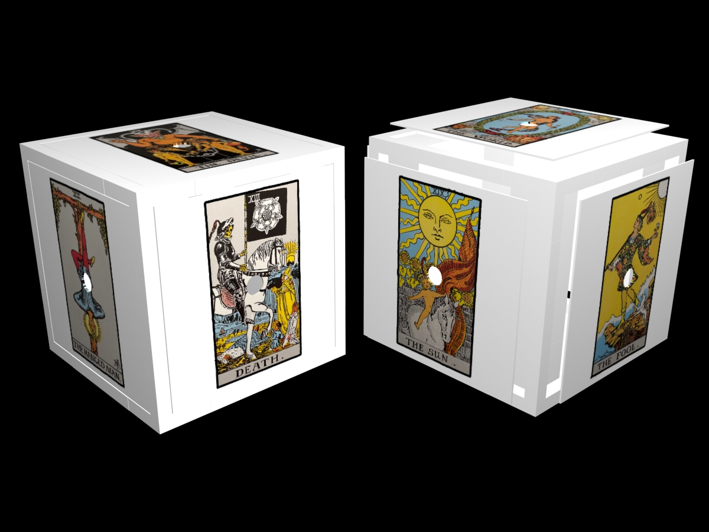
Goal
Design and fabricate a cube that connects to a computer and based on the side it lands on when rolled commands a musical result.

Slide 3
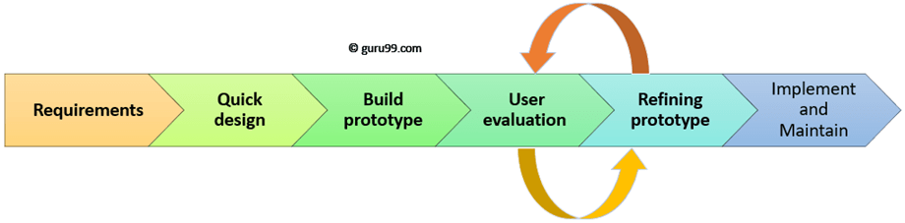
Term Plan
Develop and understanding of requirements
Select components and design cube around them
Fabricate cube
Evaluate cube
Prototype design

Slide 4
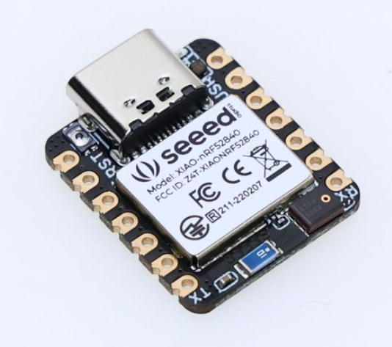
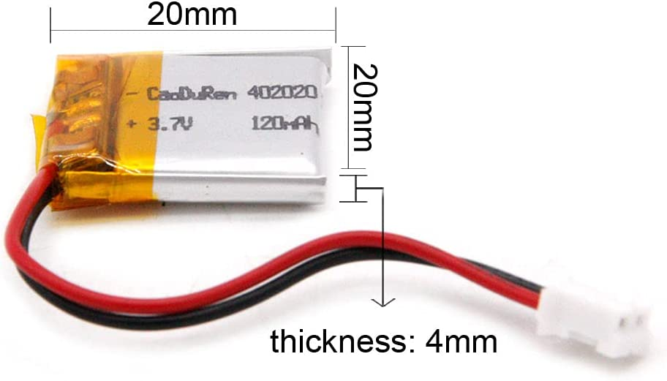
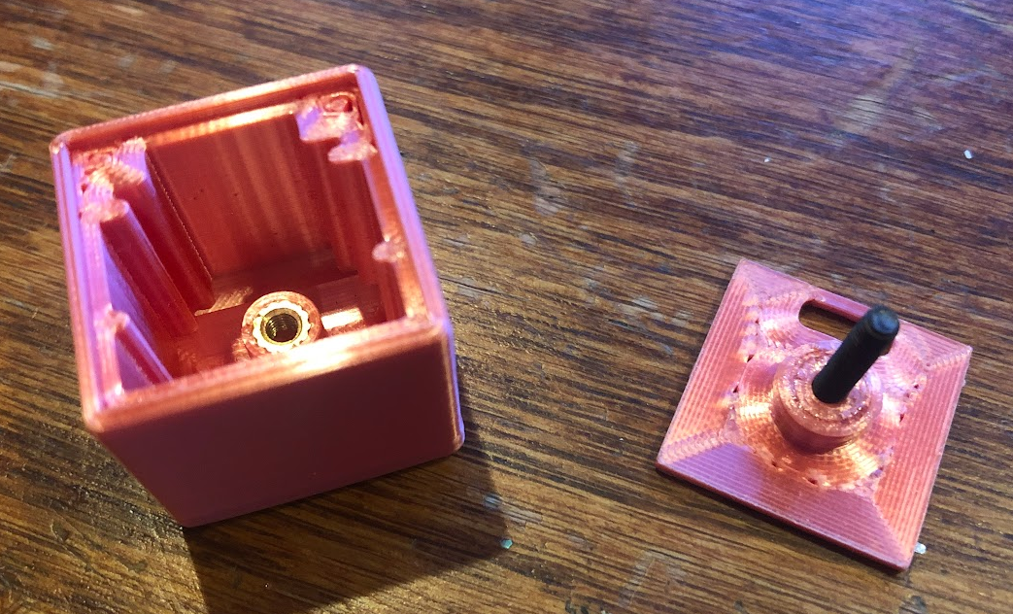
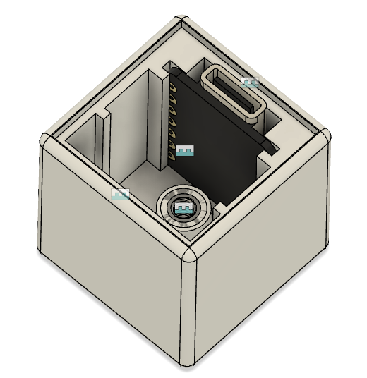
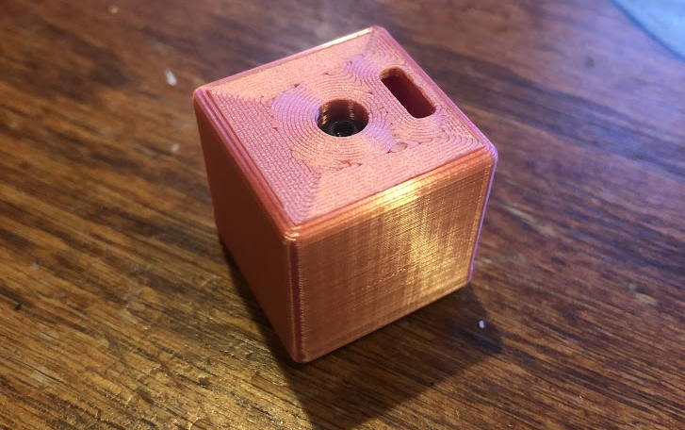
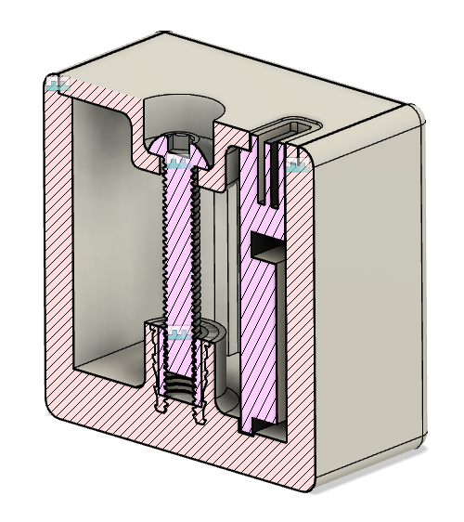
Accomplishments
Met several times to discuss project
Purchased a good microcontroller / accelerometer combo (Seeed Studio XIAO nRF52840) and a battery
Designed and printed a model of what the cube could look like

Slide 5
Questions
Is sticking stickers to the sides of the cube fine?
Are there any design constraints we should keep in mind?
Should we make it heavy or light
Is a 1” cube too small

